Slide 1

MindMagic
July 2024
STHANDARD MUTH
Team Members: Raunak Khanna, Mahatav Arora, Aaditya Golash

Slide 2
MindMagic
September 2024
WHAT IS STHANDARD MUTH?
स्थान (Sthān): Place or location in Hindi, referring to physical or figurative space.
दर्द (Dard): Pain in Hindi and Sanskrit, representing physical, emotional, or mental suffering.
मुत् (Muth): Monastery in Sanskrit. A place of spirits and the 'divine'.

Slide 3
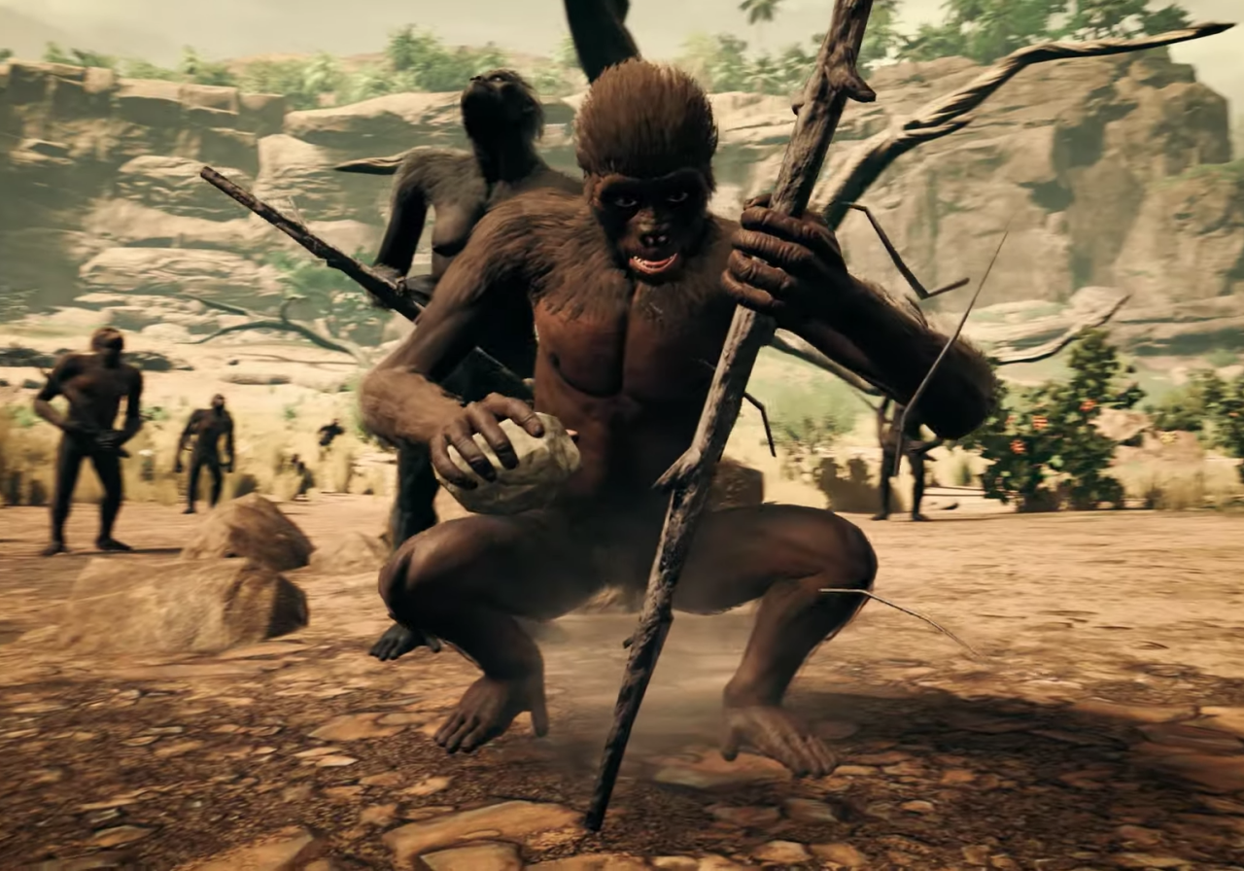
MindMagic
July 2024
Product summary
WHAT IS THE PRODUCT?
Our AI platform helps you trace your ancestry and uncover your family story. Discover who you truly are by connecting with your heritage and embracing your unique identity

Slide 4
MindMagic
July 2024
Tech Stack
Backend: Flask for API calls, Meta LLaMA for data processing.
Frontend: HTML, CSS, JavaScript, with design in Figma.
Chatbot: Amazon Q handles user interaction.
Unit Testing: ChatGPT for generating tests.
Version Control: Git, GitHub for collaboration.

Slide 5

MindMagic
July 2024
LIVE DEMO

Slide 6
MindMagic
July 2024
CHALLENGES:
API
CHATBOT
INTEGRATION

Slide 7
MindMagic
July 2024
What does the future hold?

Slide 8
MindMagic
July 2024
“
DNA was the first three-dimensional Xerox Machine
— Kenneth Ewart Boulding

Slide 9
MindMagic
THE END

Slide 10
